Slide 1
Git Branching

Slide 2
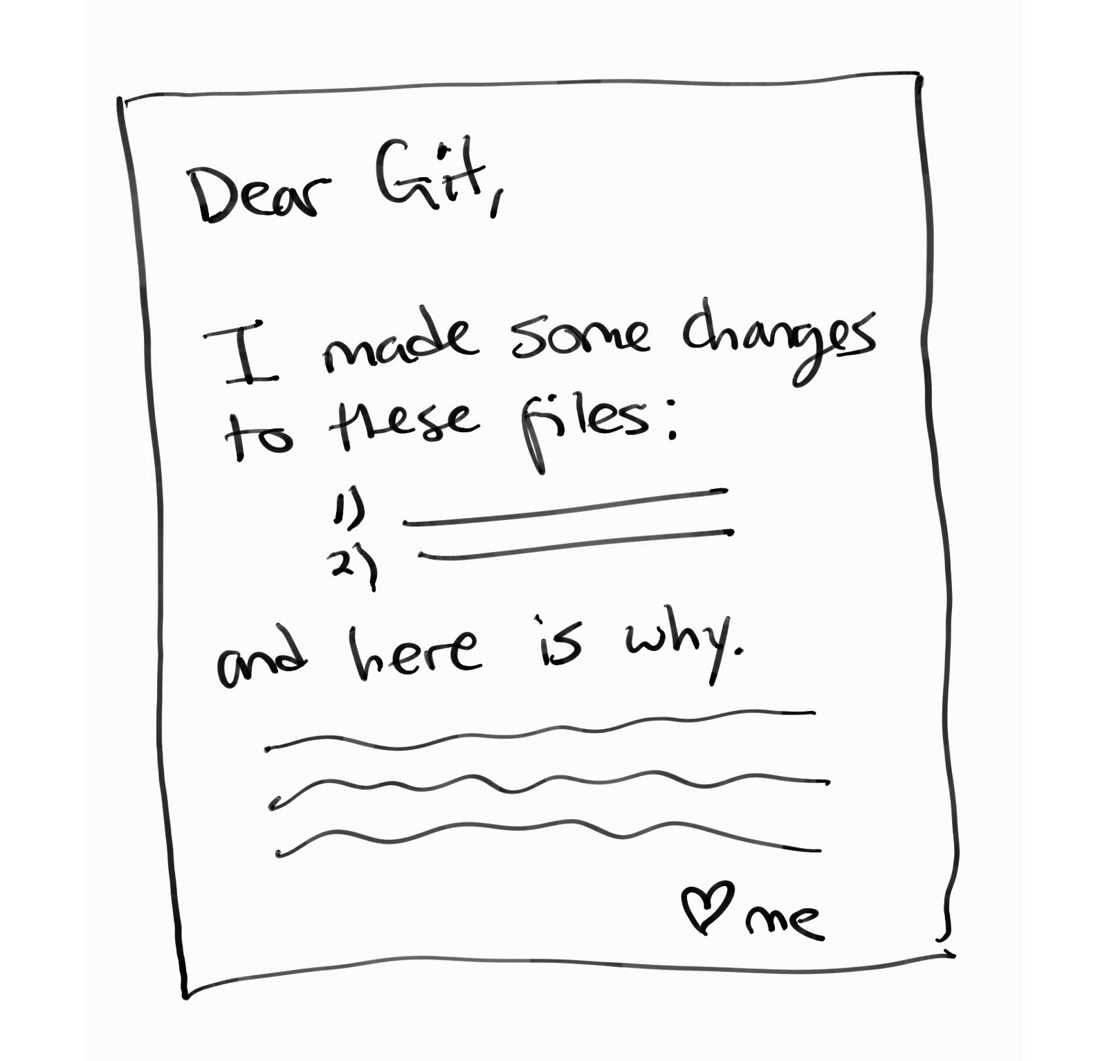

Slide 3
Git’s Snapshot Model
“...Git thinks of its data more like a set of snapshots of a miniature filesystem. Every time you commit, or save the state of your project in Git, it basically takes a picture of what all your files look like at that moment and stores a reference to that snapshot. To be efficient, if files have not changed, Git doesn’t store the file again, just a link to the previous identical file it has already stored. Git thinks about its data more like a stream of snapshots.”

Slide 4
